Slide 1

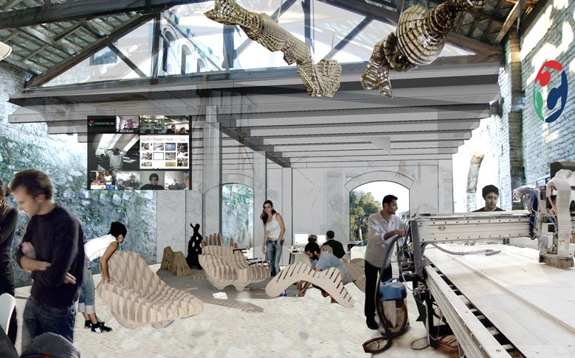
SPONSORSHIP PROPOSAL
新FAB / XINFAB 2014

Slide 2
« In an age of open source, custom-fabricated,
DIY product design, all you need to conquer
the world is a brilliant idea. »
Neil Gershenfeld

Slide 3
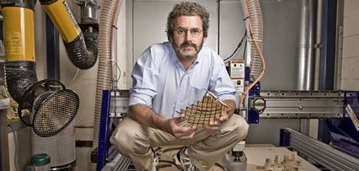
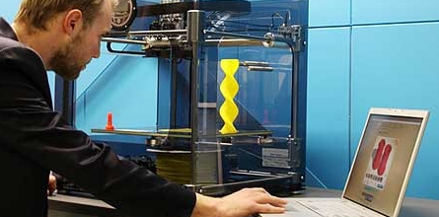
AN INTRODUCTION TO FABLABS
In 2003, the first FabLab started off as an outreach
project for MIT’s Center for Bits and Atoms to push the current limits of digital fabrication technology. Since their first days at MIT, FabLabs have spread across the globe, creating a worldwide network of facilities where users can use the latest machines and tools to transform their project ideas and solutions from idea to reality.
FabLabs gives users access to industrial-grade fabrication and electronics tools that allow them to make almost anything that current technology can allow, and serve a wide variety of users, from farmers and adults to entrepreneurs and children.
website: http://fab.cba.mit.edu/
Neil Gershenfeld, professor from MIT Center for Bits & Atoms, founder of the FabLab concept.
3D printing is one example of digital fabrication that FabLabs offer users access to

Slide 4
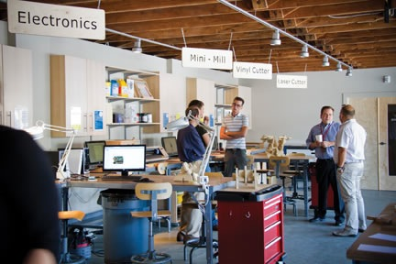
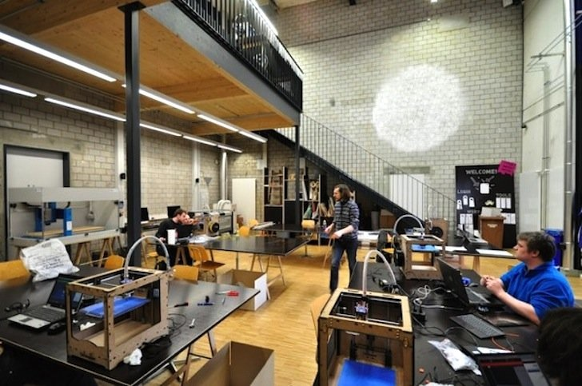
AN INTRODUCTION TO FABLABS
Where can FabLabs be found?
There are currently 267 FabLabs that can be found in over 40 countries. This global network acts a platform for users to seamlessly share processes and designs regardless of borders and distance.
Fab Lab Tulsa
Fab Lab Luzern

Slide 5
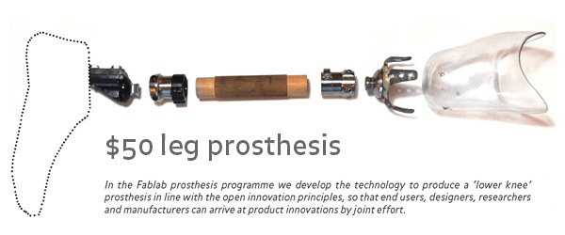
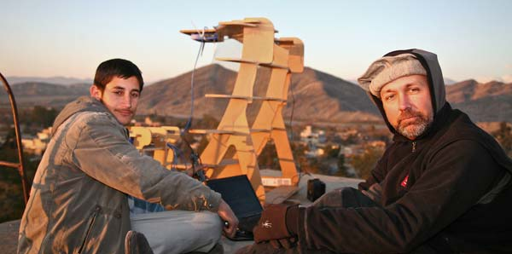
AN INTRODUCTION TO FABLABS
What kind of projects have been built in FabLabs?
There are a wide variety of FabLab projects that have been built, including solar and wind-power projects, simple computers and wireless data networks, analytical instrumentation for agriculture and healthcare, custom housing, and rapid-prototyping of rapid-prototyping machines.
Low cost leg prosthesis developed in FabLab Amsterdam
DIY wireless networks developed for Afghanistan

Slide 6

WHAT IS XINFAB?
The goal of XinFab is to give the Shanghai community of makers, inventors and startups access to cutting-edge fabrication tools and technologies at the lowest cost possible, so that every man, woman and child with a project idea and the willpower to see it through can afford the means to make their ideas into reality.
We've recently acknowledged as an offical FabLab on FabLab's global network. https://www.fablabs.io/xinfab
Weibo: @XinFab新Fab

Slide 7
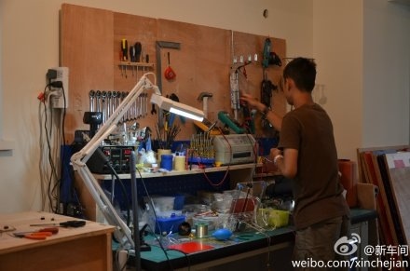
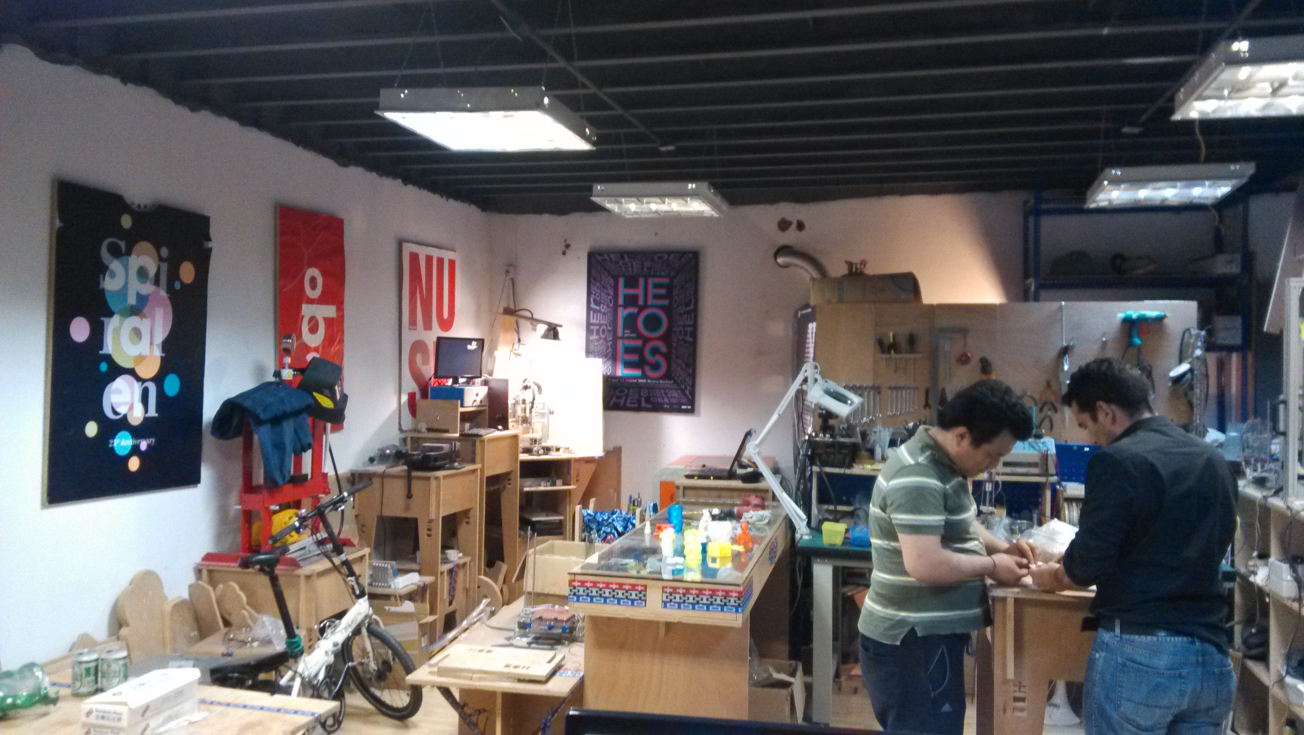
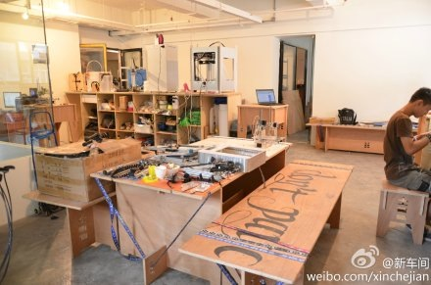
WHAT IS XINFAB?
Where is XinFab located?
XinFab is located next to the hackerspace Xinchejian, in a hardware startup co-working space near Jing'an Temple, set to open on September 13th. This location places XinFab in the business heart of Shanghai, making collaboration and transportation very convenient. The XinFab space will include 3 workshop zones: metal, wood and plastic. Shared areas with the the co-working space will include public areas, meeting rooms, a kitchen and dining area.
our current venue
Our current venue

Slide 8
WHAT IS XINFAB?
What kind of tools do XinFab members currently have access to?
At the moment, XinFab features a laser cutter, CNC machines, TIG and spot welding machines, a selection of 3D printers, a 3D scanner, computers to design 3D models on, a hydraulic press, a lathe, IR PCB oven, soldering stations and a wide assortment of hand and power tools
What kind of tools will XinFab members have access to in the future?
For the future, we hope to have hand tools, machinig, measurement, prototyping, plasma cutter, wood working.

Slide 9
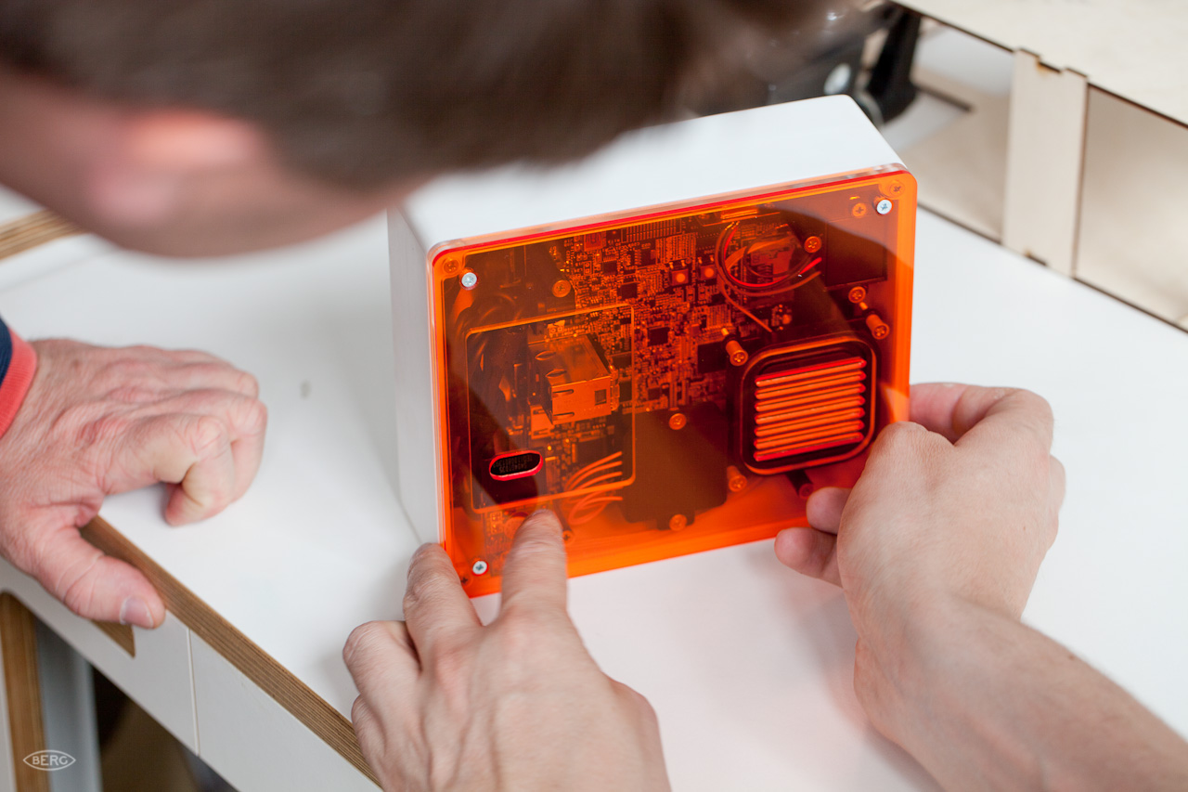
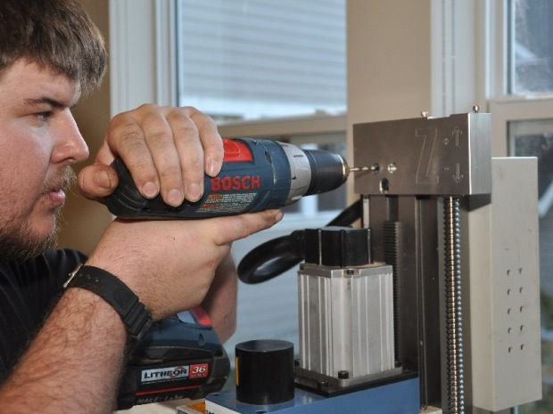

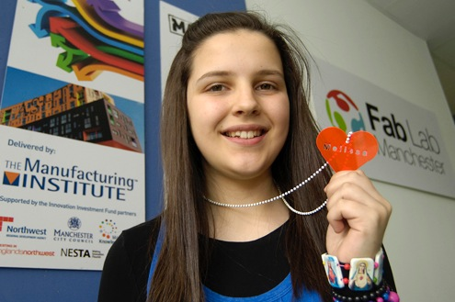
WHO WILL USE XINFAB?
Startups
Makers/hackers/inventors
designers and artists
The next generation of makers

Slide 10
WHAT IS XINFAB?
How much will it cost to become a XinFab member? Will it truly be accessible to the public?
For as little as 20 RMB, XINCHEJIAN members can become XinFab member and have access to basic XinFab tools and services. Members who wish to use the advanced suite of fabrication tools will only pay 100 or 180RMB/month
What other services will XinFab offer?
WORKSHOPS
Scheduled events for XinFab will include training for machines, equipment and software such as 3D printing, CNC, laser cutting, CAD software, etc. that will teach members the concepts and vocabulary necessary to understand digital fabrication.
PROTOTYPING
Members can present concepts for their prototype devices to XinFab and pay a fee to have their prototypes built by XinFab members.

Slide 11
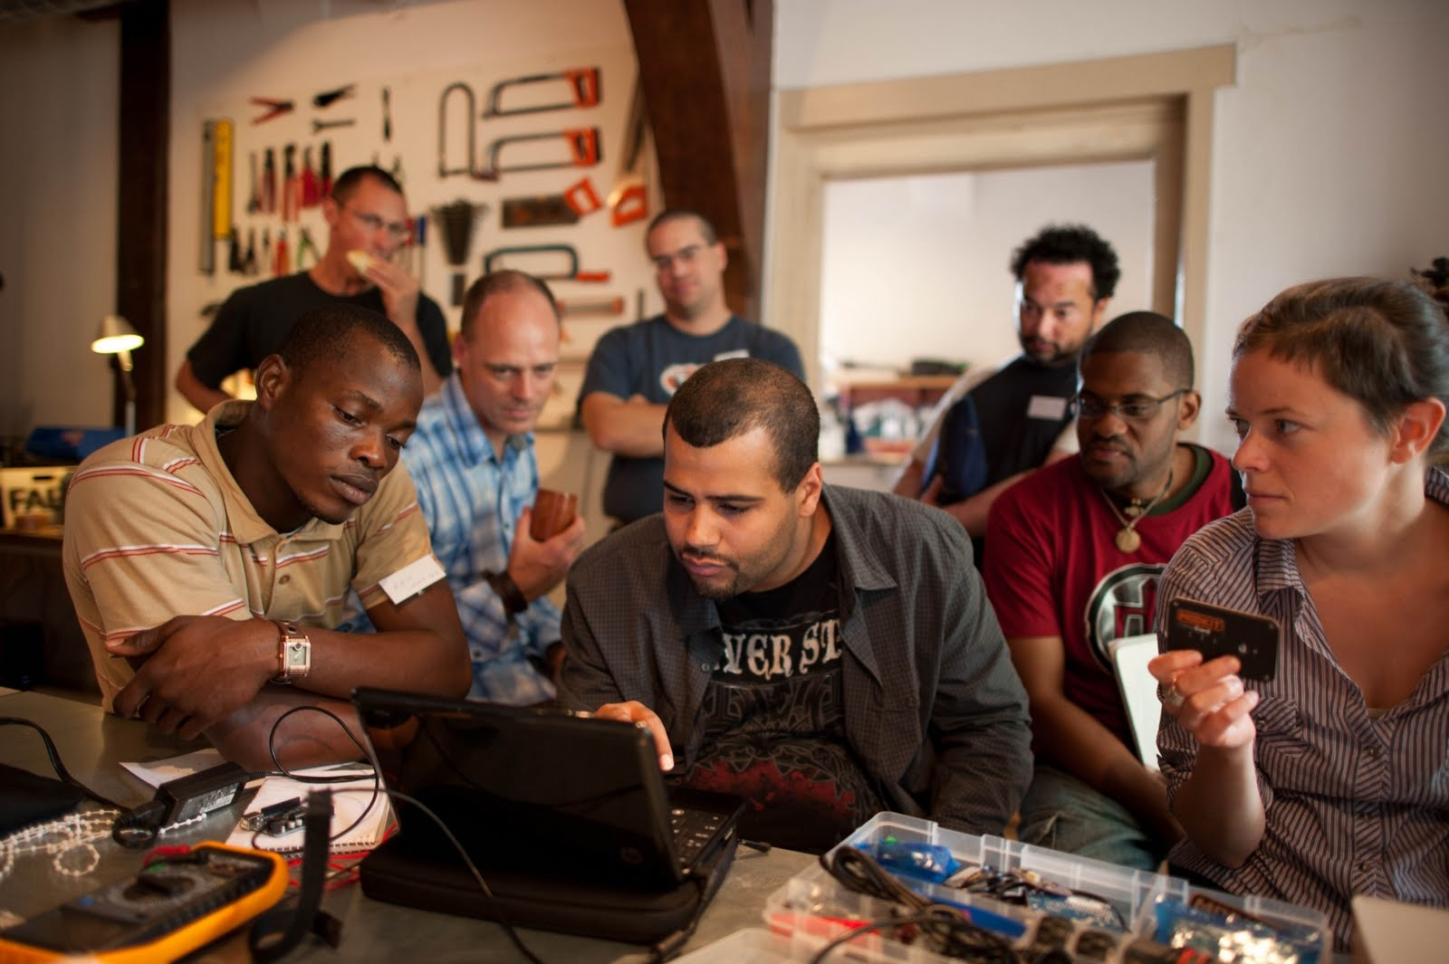
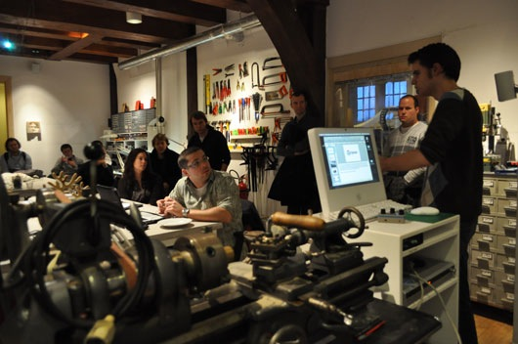
WHAT KIND OF COMMUNITY WILL XINFAB OFFER PEOPLE?
Knowledge sharing
Members with professional-grade skills can initiate to hold workshops and other training activities. In addition to these events, XinFab will also act as a platform for new makers to meet and learn from experienced makers in the community.
Open house event
Once per week XinFab will open its doors to the public for free and give anyone who shows up free access to XinFab tools to build whatever they want. In returns, XinFab will only ask them to document and share their work with the community.
Global FabLab community
As part of the global FabLab community, XinFab will be constantly sharing knowledge and designs and collobarating with other FabLabs across the world, giving members the chance to interact with the world of makers outside of Shanghai.

Slide 12
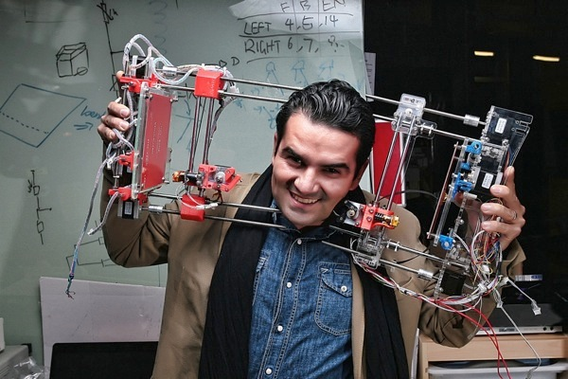
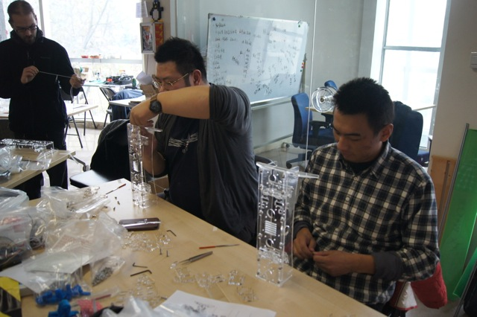
WHO IS THE FOUNDER OF XINFAB?
Lucio Pentagna
Key Areas of Expertise:
• Tech hardware
• 3D printing
• Prototyping
• Making things
Introduction:
Lucio is a Brazilian national who has lived in Shanghai since 2011. He is an active staff member of the first hackerspace in China, Xinchejian, and has built a custom designed 3D printer from scratch. Since then, he turned his hobby and passion into a full-time job by creating XinFab, a platform to help people to invent, prototype and make!
Weibo: @Lucio鲁修
Lucio Pentagna
One of many 3D printer workshops that Lucio has run over the past years

Slide 13
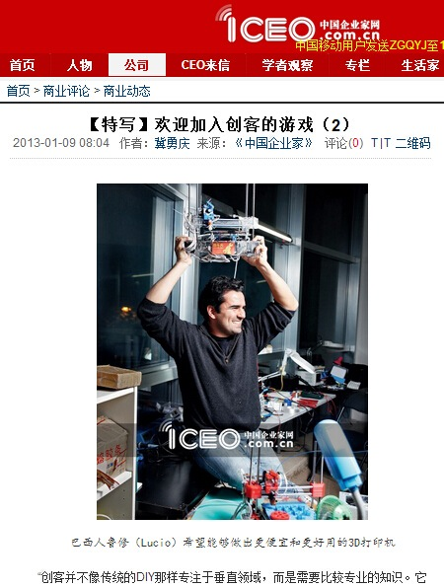
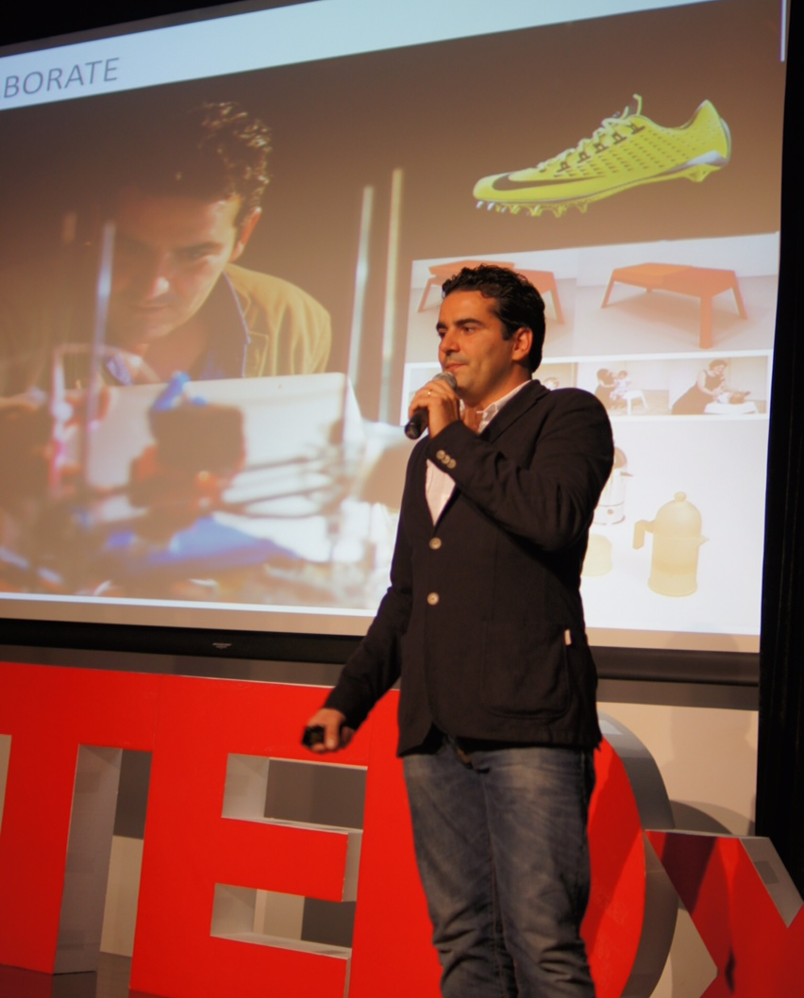
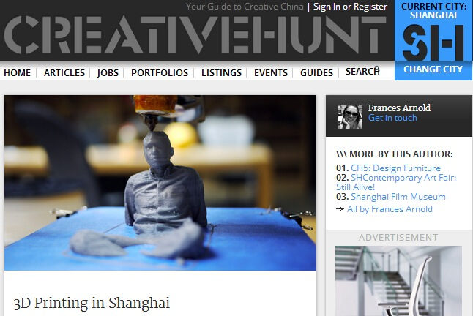
WHERE HAS LUCIO’S WORK BEEN FEATURED?
TED
ICEO 中国企业家网
CREATIVE HUNT SH

Slide 14


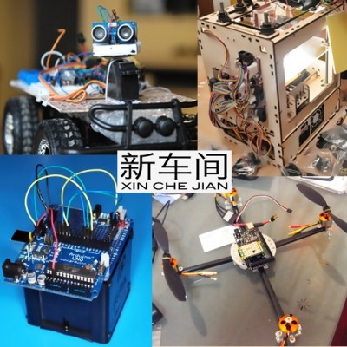
WHAT IS XINCHEJIAN AND HOW IS IT RELATED XINFAB?
Xinchejian
Xinchejian is the first and most well-known hacker space in China. Founded in 2010, Xinchejian features a robust maker community of over 600 active members,
Lucio completed many maker projects at Xinchejian, and from his positive experiences at Xinchejian, decided to start XinFab as a sister organization to Xinchejian so that more advanced tools and services could be accessible to the maker community and anybody else who is interested in building things.

Slide 15
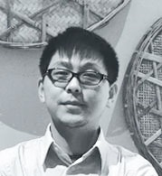
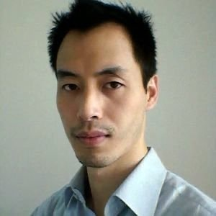
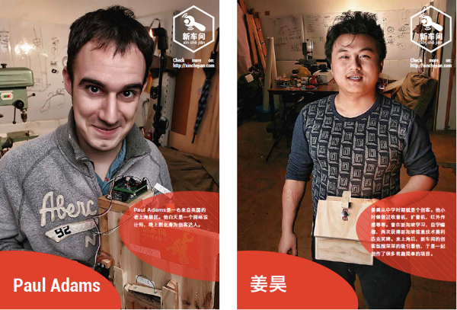
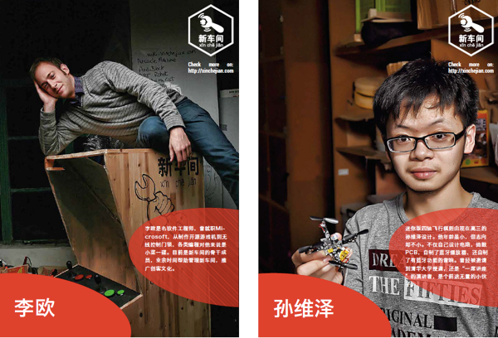
OUR ADVISORY BOARD
Jeff Ding
Professor @ Tongji University
M.Des, GSD Harvard University
Kevin Chen
CEO @ italk.com
staff member @ Xinchejian
Edward Li
Stakeholder @ Xinchejian
Lionello Lunesu
Stakeholder @ Xinchejian

Slide 16
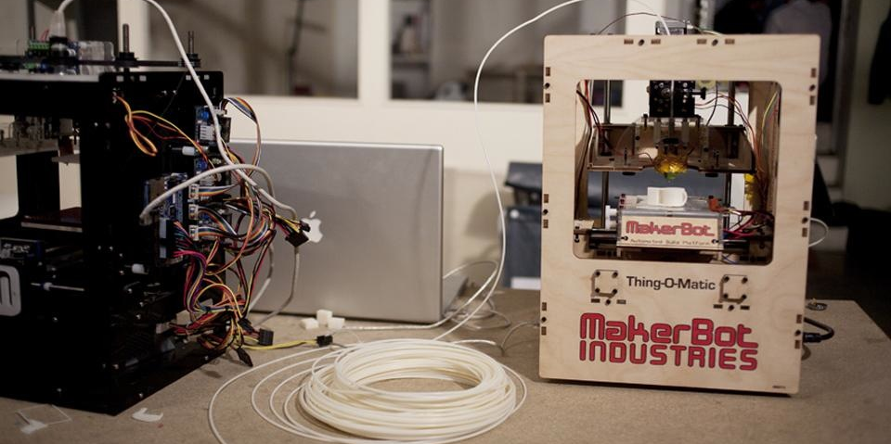
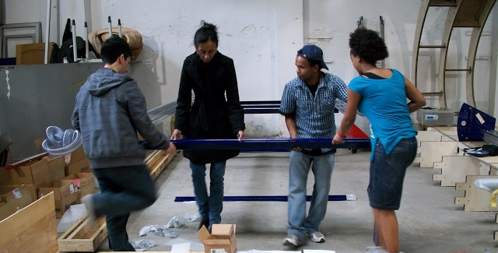
WHAT KIND OF SUPPORT IS XINFAB LOOKING FOR?
Although over 150,000 RMB has been invested in XinFab already, XinFab is looking for sponsors to help support its goal of making cutting-edge fabrication tools available to the public at an affordable and fair fee.
Some examples of supporting XinFab is seeking:
Donations
Fabrication tools, materials, supplies, software, training
Cash Sponsorship
• To keep our membership fees as low as possible to increase public access to XinFab.
• To maintain administrative and technical staff to take care of the space and its machines.
• To cover operational costs rent and replenish consumable supplies.

Slide 17
WHAT WILL MY COMPANY GET IN RETURN?
Positive brand image and associations
Through XinFab events and activities and the successful projects of its members, your company will gain press and public relations opportunities that will cultivate a brand image that is positively associated with innovation and social outreach.
A multi-purpose venue for clients, vendors and staff
Clients and vendors can visit XinFab to see your company’s products in action, and staff can get hands-on experience with your company’s products and interface with users on a personal level.
A channel for user feedback and sales
New concepts, products and services can be tested on potential users, giving your company valuable feedback that can help improve and guide development. XinFab will provide an annual report to give feedback on specific machines, services and brand reputation for XinFab sponsors.

Slide 18
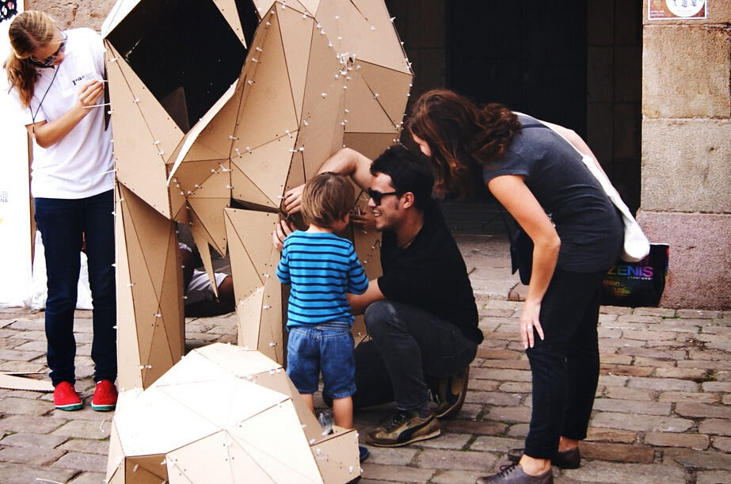
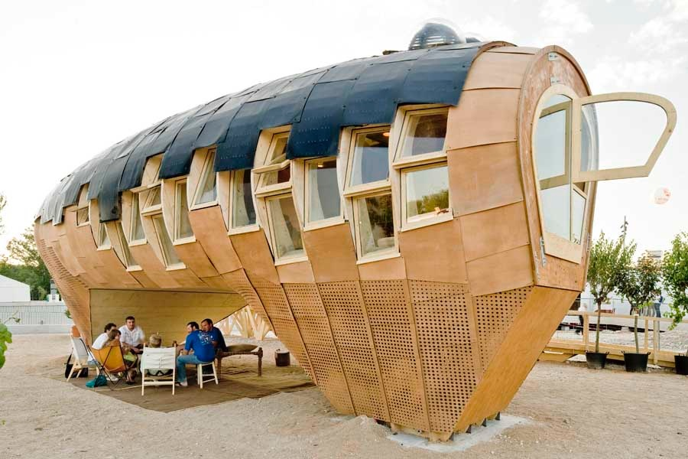
SPONSORSHIP OPPORTUNITIES
Benefits：
• Your logo at XinFab's reception
• Mention in press release
• Sponsor recognition and on the sponsorship page on the XinFab website
• Host corporate events with assistance of our staff. e.g. Hackathon, staff training, customers relationship maintaince event
• Annual report of feedback on brand awareness, machine or software.
Want to fine-tune your promotional strategy?
We're happy to help you create a custom package
that meets your brand's need.

Slide 19
Visit us:
1st floor, 28, Yuyuan East Road
愚园东路28号1楼
Come to Open House free talks
held every Wednesday evening
For questions or more information, please e-mail sponsor@xinfab.org

